Slide 1
Importance of Grammar In English Communication
By-Dr. Rani Sarode

Slide 2
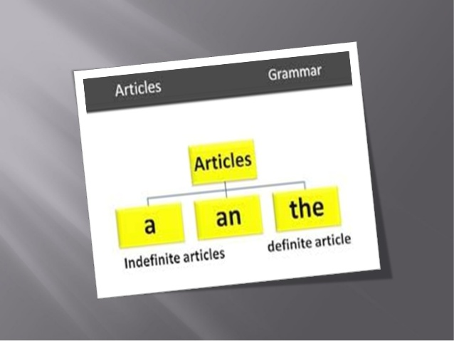

Slide 3
Articles are use to modify

Slide 4
Some confusing words: a Europian, a unit, an Honest man, an hour

Slide 6
PHRASES:
A group of related words that is used as a single part of speech.
Missing either a subject or a predicate – so NOT a complete sentence.
Eg.
Walking to school (no subject)the boy next door (no predicate)
The Evenings have turned very cold just recently.

Slide 7
Modal Auxiliaries:

Slide 14
Thank you!

